Slide 1
Chapter 10: Application Layer
Introduction to Networks
Notes:
Cisco Networking Academy program
Introduction to Networks
Chapter 10 – Application Layer

Slide 2
Chapter 10: Objectives
By the end of this chapter, you will be able to:
Explain how the functions of the application layer, session layer, and presentation layer work together to provide network services to end user applications.
Describe how common application layer protocols interact with end user applications.
Describe, at a high level, common application layer protocols that provide Internet services to end-users, including WWW services and email.
Describe application layer protocols that provide IP addressing services, including DNS and DHCP.
Describe the features and operation of well-known application layer protocols that allow for file sharing services, including: FTP, File Sharing Services, SMB protocol.
Explain how data is moved across the network, from opening an application to receiving data.
Notes:
Chapter 10 Objectives

Slide 3
Chapter 10
10.0 Introduction
10.1 Application Layer Protocols
10.2 Well-Known Application Layer Protocols and Service
10.3 The Message Heard Around the World
10.4 Summary
Notes:
Chapter 10 Sections

Slide 4
10.1 Application Layer Protocols
Notes:
10.1 Application Layer Protocols

Slide 5
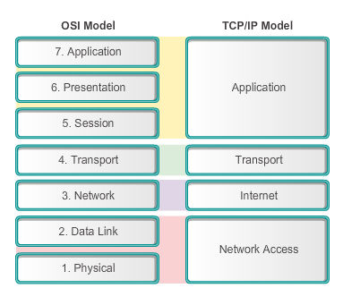
Application, Session and Presentation OSI and TCP/IP Models Revisited
The key parallels are in the transport and network layer.
Notes:
10.1.1.1 OSI and TCP/IP Models Revisited
As shown in the figure, the application layer is the top layer of both the OSI and TCP/IP models. It is the layer that provides the interface between the applications we use to communicate and the underlying network over which our messages are transmitted. Application layer protocols are used to exchange data between programs running on the source and destination hosts.
Section 4.1.1.1

Slide 6
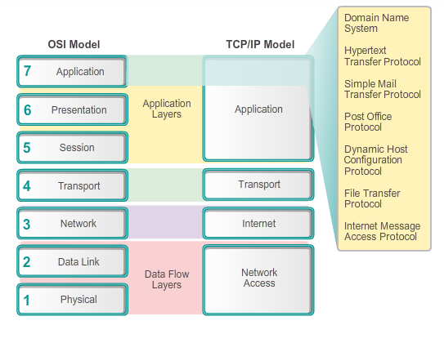
Application Session and Presentation Application Layer
Notes:
10.1.1.2 Application Layer
Most applications, like web browsers (using HTTP) or email clients (using SMTP and PoP), incorporate the functionality of the application, presentation and session layers.

Slide 7
Application, Session and Presentation Presentation and Session Layers
Presentation layer
Coding and conversion of application layer data
Data compression
Data encryption for the transmission and decryption of data upon receipt by the destination
Session layer
Functions, creates, and maintains dialogs between source and destination applications
Handles the exchange of information to initiate dialogs, keep them active, and to restart sessions
Notes:
10.1.1.3 Presentation and Session Layers

Slide 8
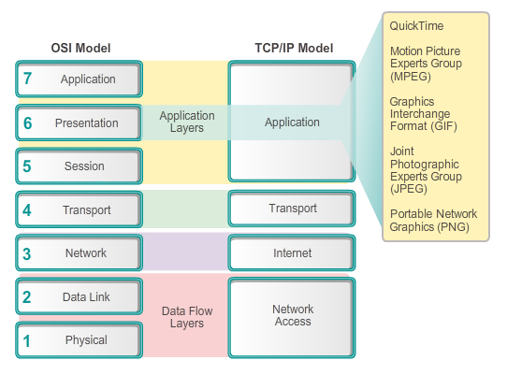
Application, Session and Presentation Presentation and Session Layers (cont.)
Notes:
10.1.1.3 Presentation and Session Layers (cont.)

Slide 9
Application, Session and Presentation TCP/IP Application Layer Protocols
Domain Name Service Protocol (DNS) – used to resolve Internet names to IP addresses
Telnet – a terminal emulation protocol used to provide remote access to servers and networking devices
Bootstrap Protocol (BOOTP) – a precursor to the DHCP protocol, a network protocol used to obtain IP address information during bootup
Dynamic Host Control Protocol (DHCP) – used to assign an IP address, subnet mask, default gateway and DNS server to a host
Hypertext Transfer Protocol (HTTP) – used to transfer files that make up the Web pages of the World Wide Web
Notes:
10.1.1.4 TCP/IP Application Layer Protocols

Slide 10
Application, Session and Presentation TCP/IP Application Layer Protocols (cont.)
File Transfer Protocol (FTP) - used for interactive file transfer between systems
Trivial File Transfer Protocol (TFTP) - used for connectionless active file transfer
Simple Mail Transfer Protocol (SMTP) - used for the transfer of mail messages and attachments
Post Office Protocol (POP) - used by email clients to retrieve email from a remote server
Internet Message Access Protocol (IMAP) – another protocol for email retrieval
Notes:
10.1.1.4 TCP/IP Application Layer Protocols (cont.)

Slide 11
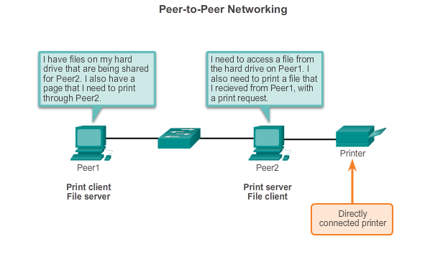
How Application Protocols Interact with End-User Applications Peer-to-Peer Networks
Both devices are considered equal in the communication.
The roles of client and server are set on a per request basis.
Notes:
10.1.2.1 Peer-to-Peer Networks
Two or more computers are connected via a network and can share resources (such as printers and files) without having a dedicated server. Every connected end device (known as a peer) can function as both a server and a client. The roles of client and server are set on a per request basis.
In this example, Peer1 has a printer attached to it directly by USB, and is setup to share the printer on the network so that Peer2 can print to it. The Peer2 is setup to share a drive or folder on the network. This allows Peer1 to access files on the shared folder, as well as save files to the shared folder. In addition to sharing files, a network such as this one would allow users to enable networked games, or share an Internet connection.
Peer-to-peer networks decentralize the resources on a network. Instead of locating data to be shared on dedicated servers, data can be located anywhere and on any connected device

Slide 12
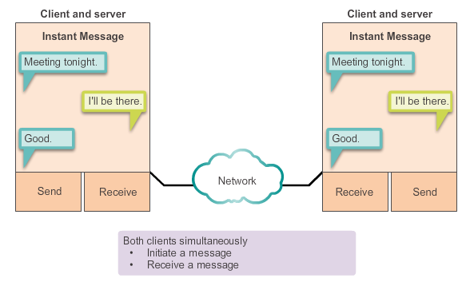
How Application Protocols Interact with End-User Applications Peer-to-Peer Applications
Client and server in the same communication.
Both can initiate a communication and are considered equal in the communication process.
Notes:
10.1.2.2 Peer-to-Peer Applications
Peer-to-peer applications can be used on peer-to-peer networks, client-server networks, and across the Internet.

Slide 13
How Application Protocols Interact with End-User Applications Common P2P Applications
With P2P applications, each computer in the network running the application can act as a client or a server for the other computers in the network running the application.
Common P2P applications include:
eDonkey
eMule
Shareaza
BitTorrent
Bitcoin
LionShare
Some P2P applications are based on the Gnutella protocol which enables people to share files on their hard disks with others
Notes:
10.1.2.3 Common P2P Applications
Many P2P applications do not use a central database to record all the files available on the peers. Instead, the devices on the network each tell the others what files are available when queried, and use the file sharing protocol and services to support locating resources.

Slide 14
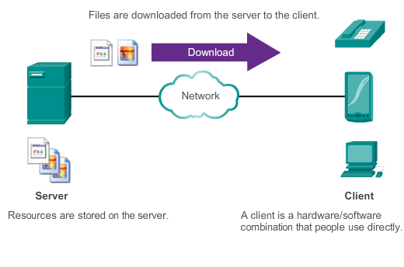
How Application Protocols Interact with End-User Applications Client-Server Model
Notes:
10.1.2.5 Client-Server Model
In the client-server model, the device requesting the information is called a client and the device responding to the request is called a server. Client and server processes are considered to be in the application layer. The client begins the exchange by requesting data from the server, which responds by sending one or more streams of data to the client

Slide 15
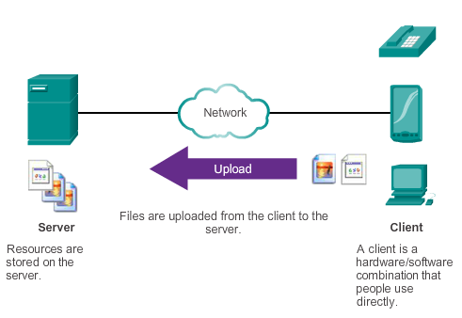
How Application Protocols Interact with End-User Applications Client-Server Model
Notes:
10.1.2.5 Client-Server Model
In the client-server model, the device requesting the information is called a client and the device responding to the request is called a server. Client and server processes are considered to be in the application layer. The client begins the exchange by requesting data from the server, which responds by sending one or more streams of data to the client

Slide 16
10.2 Well-Known Application Layer Protocols and Services
Notes:
10.2 Well-Known Application Layer Protocols and Services

Slide 17
Common Application Layer Protocols Application Layer Protocols Revisited
Three application layer protocols involved in everyday work or play include:
HTTP to browse the web.
Simple Mail Transfer Protocol (SMTP) to enable users to send email.
Post Office Protocol (POP) to enable users to receive email.
Notes:
10.2.1.1 Application Layer Protocols Revisited

Slide 18
Common Application Layer Protocols Hypertext Transfer Protocol and Hypertext Markup Language
Example URL: http://www.cisco.com/index.html
First, the browser interprets the three parts of the URL:
http (the protocol or scheme)
www.cisco.com (the server name)
index.html (the specific file name requested)
Browser checks with a name server to convert www.cisco.com into a numeric address
Using the HTTP protocol requirements sends a GET request to the server and asks for the file index.html
Server sends the HTML code for this web page
Browser deciphers the HTML code and formats the page
Notes:
10.2.1.2 Hypertext Transfer Protocol and Hypertext Markup Language

Slide 19
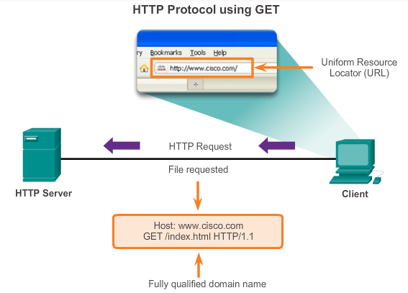
Common Application Layer Protocols HTTP and HTTPS
Developed to publish and retrieve HTML pages
Used for data transfer
Specifies a request/response protocol
Three common message types are GET, POST, and PUT
GET is a client request for data
POST and PUT are used to send messages that upload data to the web server
Notes:
10.2.1.3 HTTP and HTTPS

Slide 20
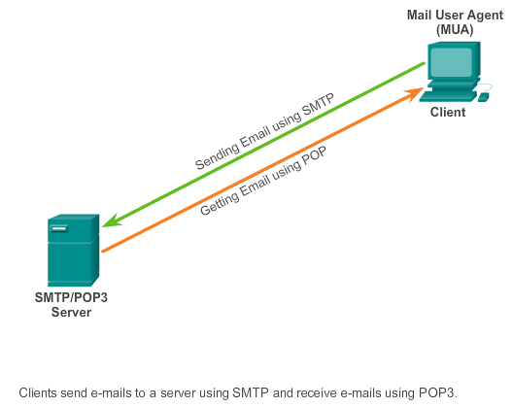
Common Application Layer Protocols SMTP, POP, and IMAP
Typically use an application called a Mail User Agent (email client)
Allows messages to be sent
Places received messages into the client's mailbox
SMTP - Send email from either a client or a server
POP - Receive email messages from an email server
IMAP - Internet Message Access Protocol
Email client provides the functionality of both protocols within one application
Notes:
10.2.1.4 SMTP, POP, and IMAP

Slide 21
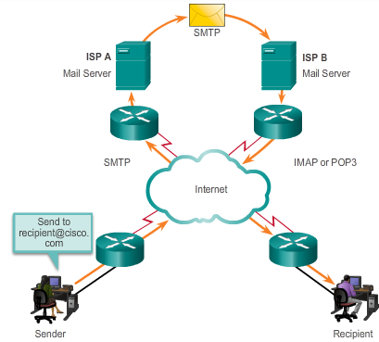
Common Application Layer Protocols SMTP, POP, and IMAP (cont.)
Notes:
10.2.1.4 SMTP, POP, and IMAP (cont.)

Slide 22
Common Application Layer Protocols SMTP, POP, and IMAP (cont.)
Simple Mail Transfer Protocol (SMTP)
transfers mail
message must be formatted properly
SMTP processes must be running on both the client and server
message header must have a properly formatted recipient email address and a sender
uses port 25
Post Office Protocol (POP)
enables a workstation to retrieve mail from a mail server
mail is downloaded from the server to the client and then deleted on the server
uses port 110
POP does not store messages
POP3 is desirable for an ISP, because it alleviates their responsibility for managing large amounts of storage for their email servers
Notes:
10.2.1.5 SMTP, POP, and IMAP (cont.)

Slide 23
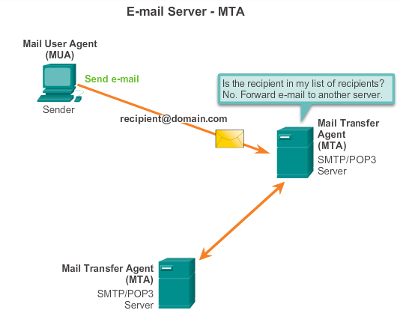
Common Application Layer Protocols SMTP, POP, and IMAP (cont.)
Notes:
10.2.1.5 SMTP, POP, and IMAP (cont.)

Slide 24
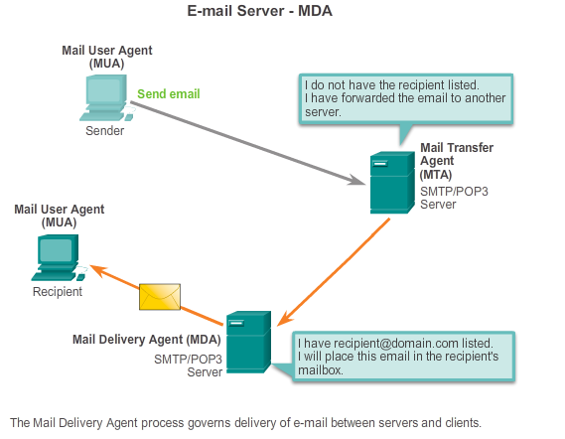
Common Application Layer Protocols SMTP, POP, and IMAP (cont.)
Notes:
10.2.1.6 SMTP, POP, and IMAP (cont.)

Slide 25
Everyday Application Layer Protocols SMTP, POP, and IMAP (cont.)
MDA accepts a piece of email from MTA and performs the actual delivery.
MDA receives all the inbound mail from the MTA and places it into mailboxes.
MDA can also resolve final delivery issues, such as virus scanning, spam filtering, and return-receipt handling.
Notes:
10.2.1.6 SMTP, POP, and IMAP (cont.)

Slide 26
Common Application Layer Protocols SMTP, POP, and IMAP (cont.)
Simple Mail Transfer Protocol (SMTP)
Transfers mail reliably and efficiently
Post Office Protocol (POP)
Enables a workstation to retrieve mail from a mail server
With POP, mail is downloaded from the server to the client and then deleted on the server
Internet Message Access Protocol (IMAP)
Another protocol that to retrieves email messages
Unlike POP, when the user connects to an IMAP-capable server, copies of the messages are downloaded to the client application
Original messages are kept on the server until manually deleted
Notes:
10.2.1.7 SMTP, POP, and IMAP (cont.)

Slide 27
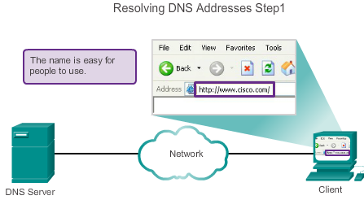
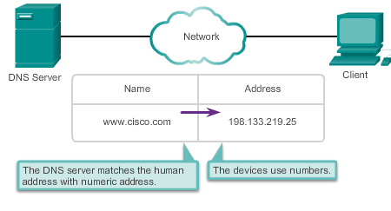
Providing IP Addressing Services Domain Name Service
A human legible name is resolved to its numeric network device address by the DNS protocol.
Notes:
10.2.2.1 Domain Name Service

Slide 28
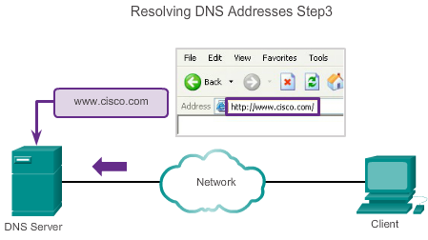
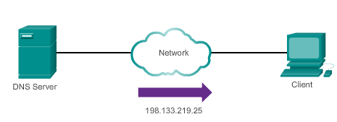


Providing IP Addressing Services Domain Name Service (cont.)
A human legible name is resolved to its numeric network device address by the DNS protocol.
Notes:
10.2.2.1 Domain Name Service (cont.)

Slide 29
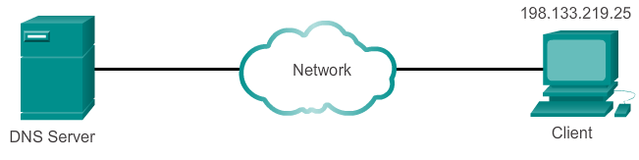
Providing IP Addressing Services Domain Name Service (cont.)
Notes:
10.2.2.1 Domain Name Service (cont.)

Slide 30
Providing IP Addressing Services DNS Message Format
DNS server stores different types of resource records used to resolve names
Contains the name, address, and type of record.
Record types are:
A – An end device address
NS – An authoritative name server
CNAME – The canonical name for an alias; used when multiple services have the single network address, but each service has its own entry in DNS
MX – Mail exchange record; maps a domain name to a list of mail exchange servers
Unable to resolve the name using its stored records, contacts other servers.
Server temporarily stores the numbered address that matches the name in cache memory.
Windows ipconfig /displaydns displays all cached DNS.
Notes:
10.2.2.2 DNS Message Format

Slide 31
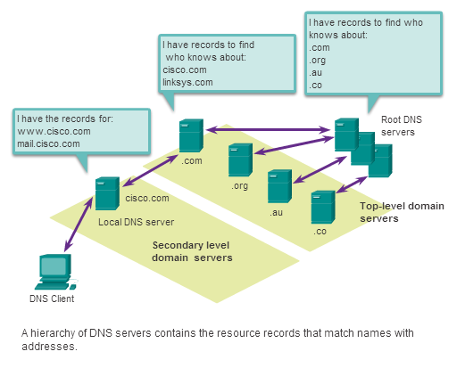
Providing IP Addressing Services DNS Hierarchy
Examples top-level domains:
.au - Australia
.co - Colombia
.com - business or industry
.jp - Japan
.org - non-profit organization
Notes:
10.2.2.3 DNS Hierarchy

Slide 32
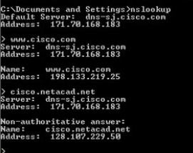
Providing IP Addressing Services nslookup
Operating system utility called nslookup allows the user to manually query the name servers to resolve a given host name
Utility can be used to troubleshoot name resolution issues and to verify the current status of the name servers
Notes:
10.2.2.4 nslookup

Slide 33
Providing IP Addressing Services Dynamic Host Configuration Protocol
DHCP allows a host to obtain an IP address dynamically.
DHCP server is contacted and address requested - chooses address from a configured range of addresses called a pool and “leases” it to the host for a set period.
DHCP used for general purpose hosts such as end user devices, and static addressing is used for network devices such as gateways, switches, servers and printers.
Notes:
10.2.2.6 Dynamic Host Configuration Protocol

Slide 34
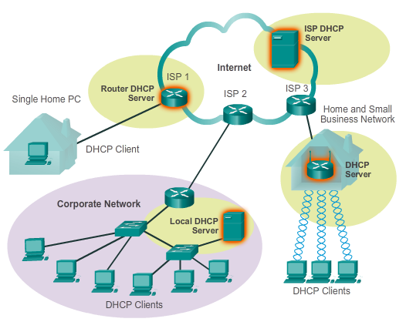
Providing IP Addressing Services Dynamic Host Configuration Protocol (cont.)
Notes:
10.2.2.6 Dynamic Host Configuration Protocol (cont.)

Slide 35
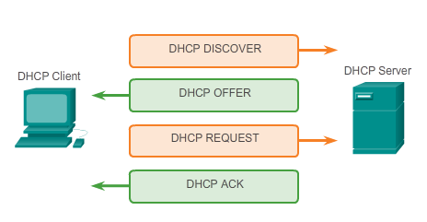
Providing IP Addressing Services DHCP Operation
Notes:
10.2.2.7 DHCP Operation

Slide 36
Providing File Sharing Services File Transfer Protocol
FTP allow data transfers between a client and a server.
FTP client is an application that runs on a computer that is used to push and pull data from a server running an FTP daemon.
To successfully transfer data, FTP requires two connections between the client and the server, one for commands and replies, the other for the actual file transfer.
Notes:
10.2.3.1 File Transfer Protocol

Slide 37
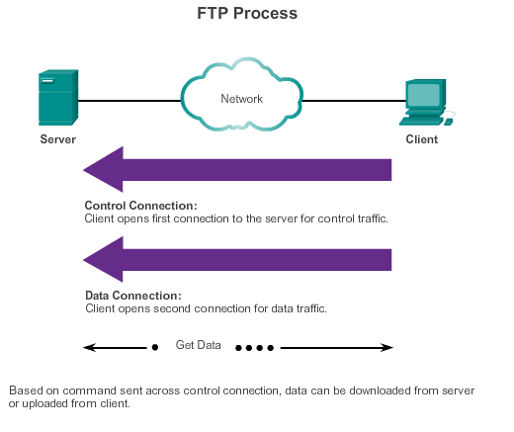
Providing File Sharing Services File Transfer Protocol (cont.)
Notes:
10.2.3.1 File Transfer Protocol (cont.)

Slide 38
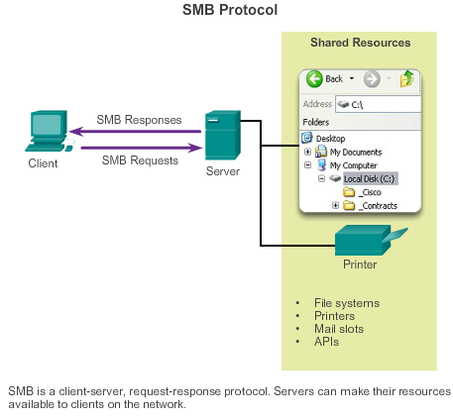
Providing File Sharing Services Server Message Block
Clients establish a long term connection to servers.
After the connection is established, the user can access the resources on the server as if the resource is local to the client host.
SMB is a client-server, request-response protocol. Servers can make their resources available to clients on the network.
Notes:
10.2.3.4 Server Message Block

Slide 39
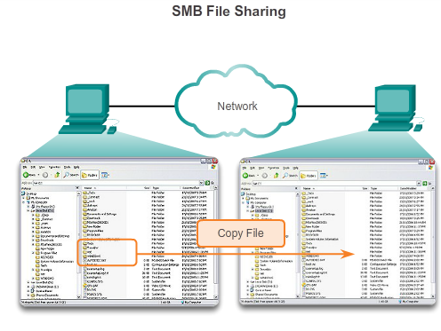
Providing File Sharing Services Server Message Block (cont.)
A file may be copied from PC to PC with Windows Explorer using the SMB protocol.
Notes:
10.2.3.4 Server Message Block (cont.)

Slide 40
10.3 The Message Heard Around the World
Notes:
10.3 The Message Heard Around the World

Slide 41
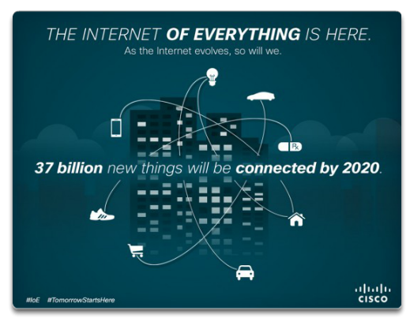
Move It! The Internet of Things
Notes:
10.3.1.1 The Internet of Things

Slide 42
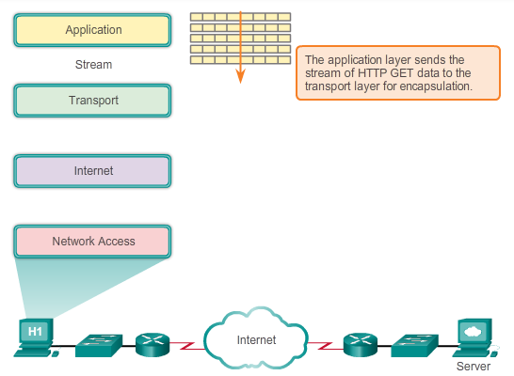
Move It! Message Travels Through a Network
Notes:
10.3.1.2 Message Travels Through a Network

Slide 43
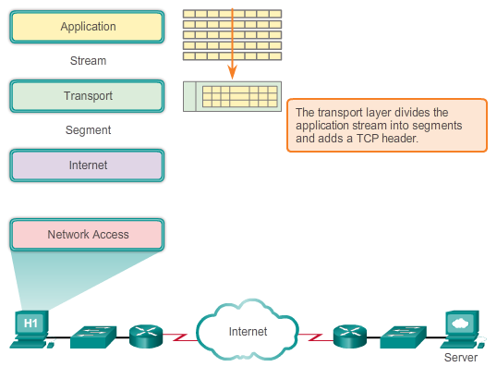
Move It! Message Travels Through a Network (cont.)
Notes:
10.3.1.2 Message Travels Through a Network (cont.)

Slide 44
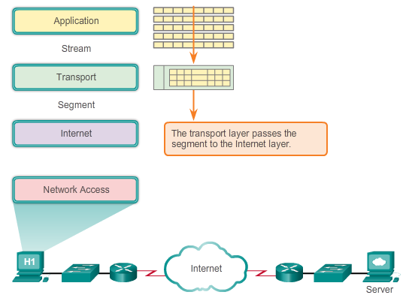
Move It! Message Travels Through a Network (cont.)
Notes:
10.3.1.2 Message Travels Through a Network (cont.)

Slide 45
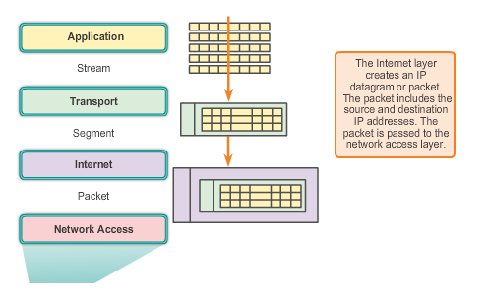
Move It! Getting the Data to the End Device
Notes:
10.3.1.3 Getting the Data to the End Device

Slide 46
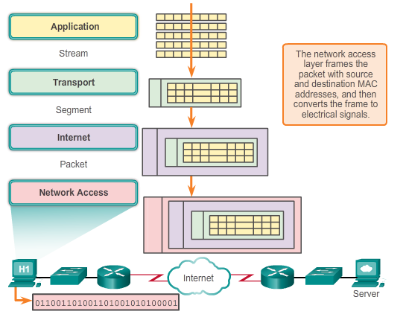
Move It! Getting the Data through the Internetwork
Notes:
10.3.1.4 Getting the Data through the Internetwork

Slide 47
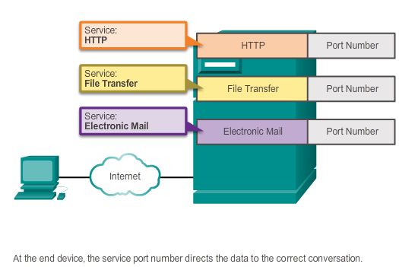
Move It! Getting the Data to the Right Application
At the end device, the service port number directs the data to the correct conversation.
Notes:
10.3.1.5 Getting the Data to the Right Application

Slide 48
Application Layer Summary
Applications are computer programs with which the user interacts and which initiate the data transfer process at the user’s request.
Services are background programs that provide the connection between the application layer and the lower layers of the networking model.
Protocols provide a structure of agreed-upon rules and processes that ensure services running on one particular device can send and receive data from a range of different network devices.
HTTP supports the delivery of web pages to end devices.
SMTP, POP, and IMAP support sending and receiving email.
Notes:
Summary

Slide 49
Application Layer Summary
SMB and FTP enable users to share files.
P2P applications make it easier for consumers to seamlessly share media.
DNS resolves the human legible names used to refer to network resources into numeric addresses usable by the network
All of these elements work together, at the application layer.
The application layer enables users to work and play over the Internet.
Notes:
Summary

Slide 50


